Slide 1
State-wise Analysis of Access to Improved Source of Drinking Water
CAPSTONE PROJECT
Presented By: ROHITH VEMURI- Saveetha School Of Engineering- BE(CSE)

Slide 2
OUTLINE
Problem Statement
Proposed System/Solution
System Development Approach (Technology Used)
Algorithm & Deployment
Result (Output Image)
Conclusion
Future Scope
References

Slide 3
Problem Statement
Access to safe and improved sources of drinking water is a critical human right and a core component of public health. While India has made significant progress in expanding access under the Sustainable Development Goals (SDG 6), inequalities persist especially in rural areas, tribal regions, and economically weaker states.
The gap in access is often influenced by geography, urbanization, socio-economic status, and infrastructure development. This project aims to analyze the state-wise and sector-wise (urban vs rural) disparities using data from the 78th Round of the Multiple Indicator Survey (MIS) to better understand these challenges and assist in data-backed policy planning.

Slide 4
Proposed System
This project proposes a data-driven approach to analyze disparities in access to improved sources of drinking water across Indian states.
The solution involves using IBM Watson Studio (on IBM Cloud Lite) as the cloud platform for data analysis.
The Multiple Indicator Survey (MIS) 78th Round dataset is processed using Data Refinery to clean, filter, and structure the data.
Key comparisons such as Urban vs Rural access and State-wise coverage were visualized using interactive bar charts to generate insights.
This supports evidence-based policy planning for water infrastructure and SDG 6 goals.

Slide 5
System Development Approach (Technology Used)
System Requirements:
IBM Cloud Lite Account
Watson Studio Project
Data Refinery
MIS Dataset from AI Kosh
Steps Followed:
Upload dataset to Watson Studio
Open in Data Refinery for cleaning
Filter by relevant indicator: Improved Source of Drinking Water
Create visualizations (Urban vs Rural, State-wise)

Slide 6
Algorithm & Deployment
This project is not machine-learning based. Instead, a logical data analysis process was used:
Data Source: MIS 78th Round – AI Kosh
Filtering: Retained only rows with the "Improved Source of Drinking Water" indicator
Processing: Grouped by Sector and State in Data Refinery
Visualization: Created bar charts for Urban vs Rural, and State-wise comparisons
Deployment: All insights extracted through IBM Watson Studio dashboard and exported

Slide 7
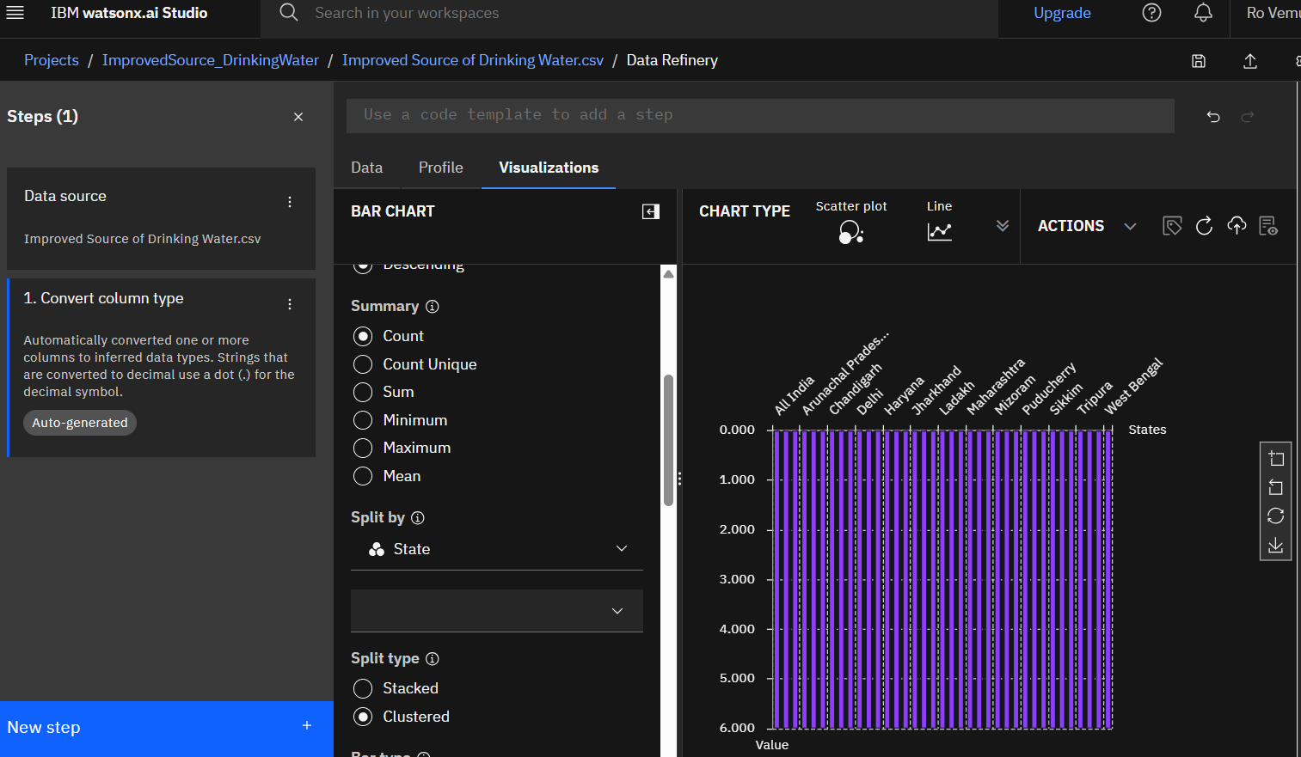
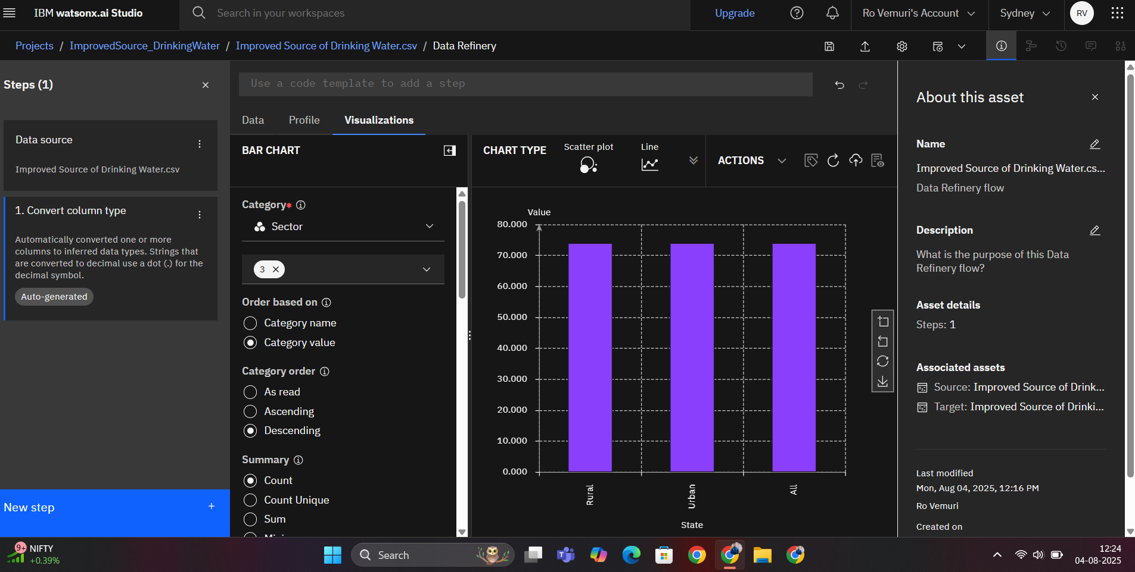
Result (Output Image)
State Wise Access to Improved Drinking Water
Urban vs Rural Access to Improved Drinking Water by State

Slide 8
Conclusion
The analysis confirms that urban areas in most states have significantly better access to improved drinking water than rural areas.
Kerala, Gujarat, and Punjab emerged as top-performing states with over 90% access across sectors. Bihar, Odisha, and Meghalaya were among the lowest, especially in the rural sector, with access below 70%.
The state-wise bar chart clearly highlighted inter-state disparities, reinforcing the need for targeted water infrastructure planning.
These findings support the Sustainable Development Goal 6 (SDG 6) ensuring clean water and sanitation for all.

Slide 9
Future Scope
Extend analysis to other MIS indicators such as type of drinking water source (piped, tanker, well) and quality of water consumed
Use time-series from other MIS rounds for trend analysis
Build Power BI or Tableau dashboards for policy planning
Explore AI/ML for predictive water access risk analysis.
This approach can support state-level planning and resource allocation in future water-related policymaking.

Slide 10
References
AI Kosh Dataset: https://aikosh.indiaai.gov.in
IBM Cloud Lite: https://cloud.ibm.com
SDG 6 Documentation (UN Sustainable Goals)

Slide 11
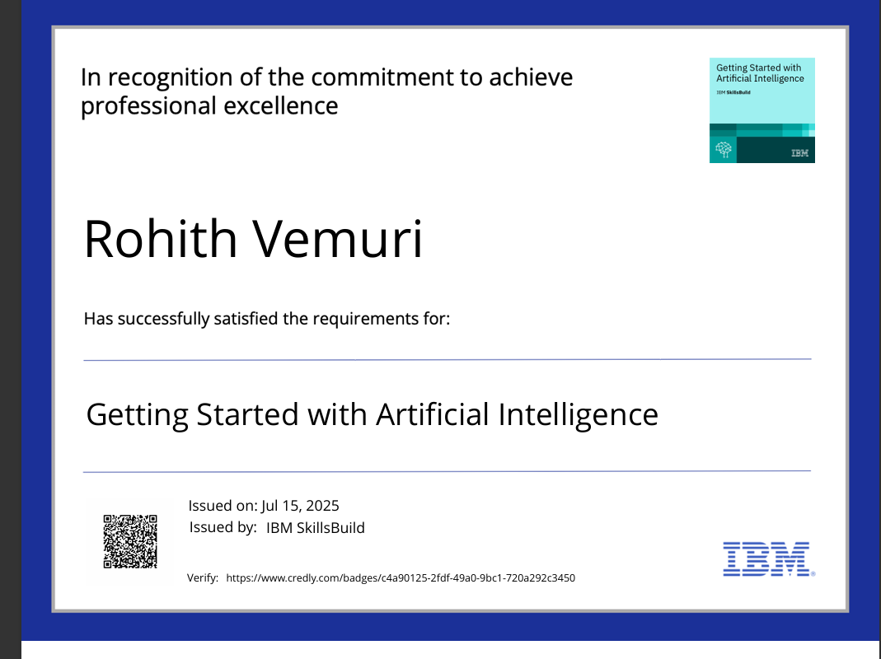
IBM CERTIFICATIONS

Slide 12
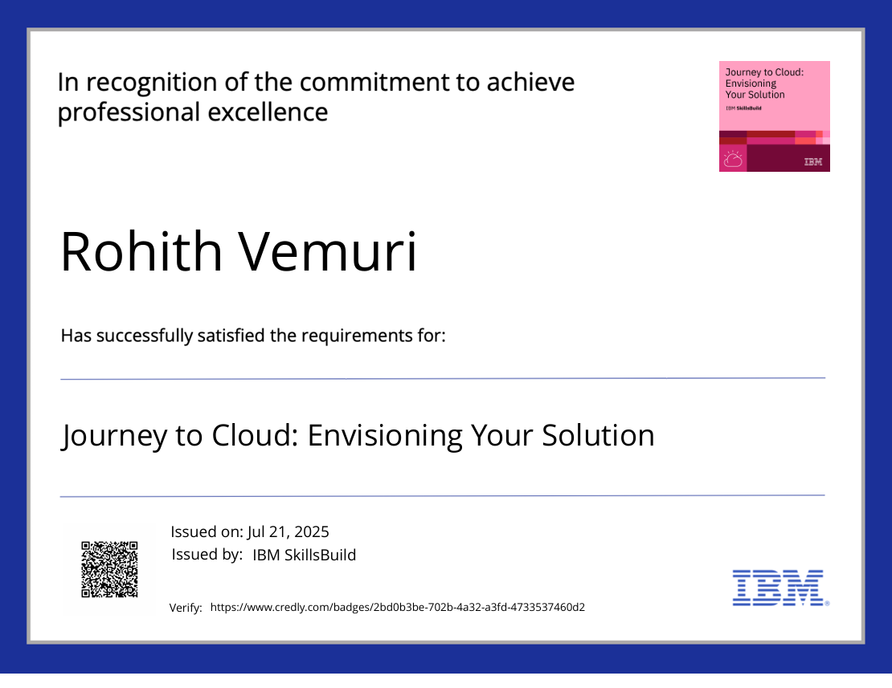
IBM CERTIFICATIONS

Slide 13
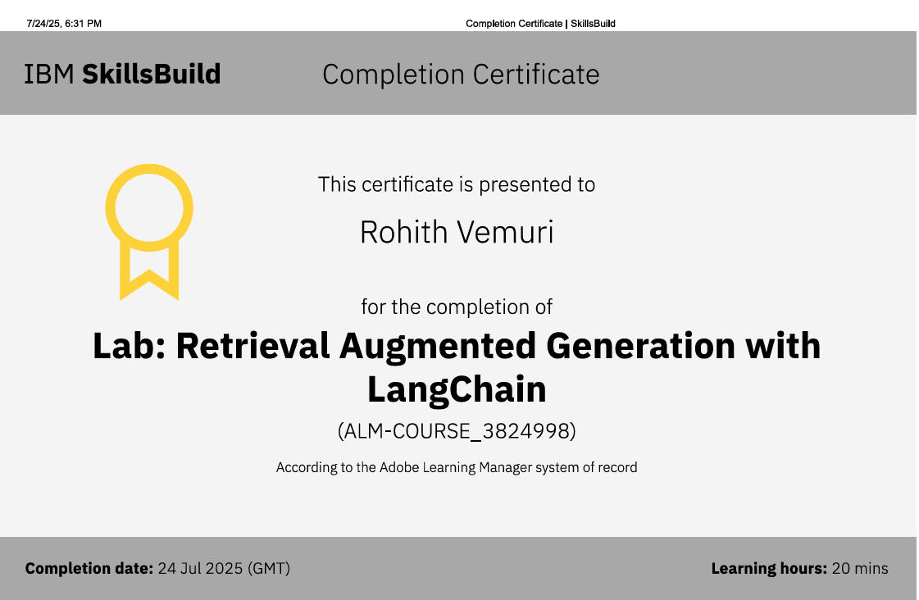
IBM CERTIFICATIONS

Slide 14
THANK YOU

